Slide 1
CS276A
Information Retrieval
Lecture 7

Slide 2
Recap of the last lecture
Parametric and field searches
  Zones in documents
Scoring documents: zone weighting
  Index support for scoring
tf×idf and vector spaces

Slide 3
This lecture
Vector space scoring
Efficiency considerations
  Nearest neighbors and approximations

Slide 4
Documents as vectors
At the end of Lecture 6 we said:
Each doc j can now be viewed as a vector of wf×idf values, one component for each term
So we have a vector space
  terms are axes
  docs live in this space
  even with stemming, may have 20,000+ dimensions

Slide 5
Why turn docs into vectors?
First application: Query-by-example
  Given a doc D, find others “like” it.
Now that D is a vector, find vectors (docs) “near” it.

Slide 6
Intuition
t₃
d₂
d₃
d₁
θ
φ
t₁
d₅
t₂
d₄
Postulate: Documents that are “close together”
in the vector space talk about the same things.

Slide 7
The vector space model
Query as vector:
We regard query as short document
We return the documents ranked by the closeness of their vectors to the query, also represented as a vector.

Slide 8
Desiderata for proximity
If d₁ is near d₂, then d₂ is near d₁.
If d₁ near d₂, and d₂ near d₃, then d₁ is not far from d₃.
No doc is closer to d than d itself.

Slide 9
First cut
Distance between d₁ and d₂ is the length of the vector |d₁ – d₂|.
  Euclidean distance
Why is this not a great idea?
We still haven’t dealt with the issue of length normalization
  Long documents would be more similar to each other by virtue of length, not topic
However, we can implicitly normalize by looking at angles instead

Slide 10
Cosine similarity
Distance between vectors d₁ and d₂ captured by the cosine of the angle x between them.
Note – this is similarity, not distance
  No triangle inequality for similarity.
t ₃
d ₂
d ₁
θ
t ₁
t ₂

Slide 11
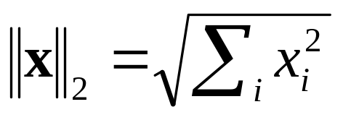
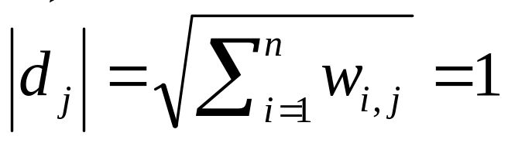
Cosine similarity
A vector can be normalized (given a length of 1) by dividing each of its components by its length – here we use the L₂ norm
This maps vectors onto the unit sphere:
Then,
Longer documents don’t get more weight

Slide 12
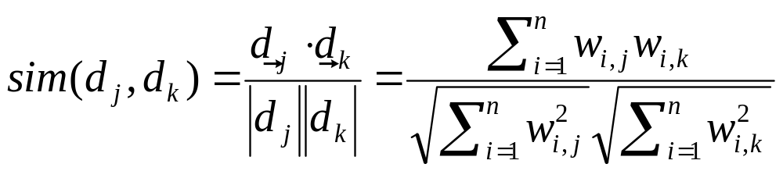
Cosine similarity
Cosine of angle between two vectors
The denominator involves the lengths of the vectors.
Normalization

Slide 13
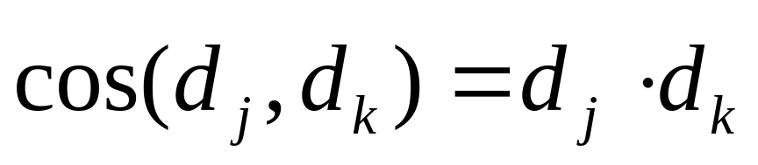
Normalized vectors
For normalized vectors, the cosine is simply the dot product:

Slide 14
Cosine similarity exercises
Exercise: Rank the following by decreasing cosine similarity:
  Two docs that have only frequent words (the, a, an, of) in common.
  Two docs that have no words in common.
  Two docs that have many rare words in common (wingspan, tailfin).

Slide 15
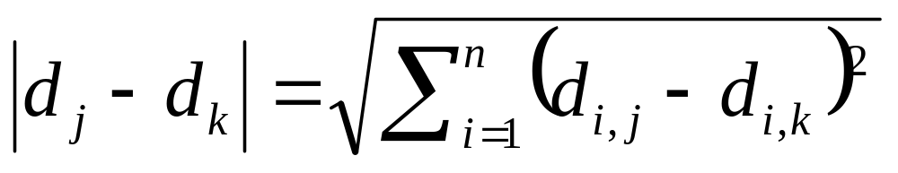
Exercise
Euclidean distance between vectors:
Show that, for normalized vectors, Euclidean distance gives the same proximity ordering as the cosine measure

Slide 16
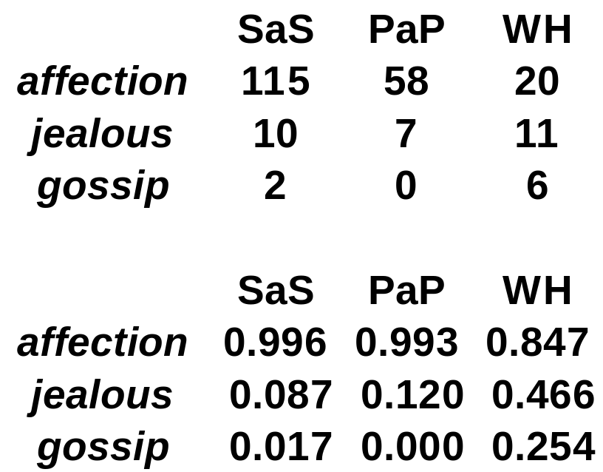
Example
Docs: Austen's Sense and Sensibility, Pride and Prejudice; Bronte's Wuthering Heights
cos(SAS, PAP) = .996 x .993 + .087 x .120 + .017 x 0.0 = 0.999
cos(SAS, WH) = .996 x .847 + .087 x .466 + .017 x .254 = 0.929

Slide 17
Digression: spamming indices
This was all invented before the days when people were in the business of spamming web search engines:
  Indexing a sensible passive document collection vs.
  An active document collection, where people (and indeed, service companies) are shaping documents in order to maximize scores

Slide 18
Summary: What’s the real point of using vector spaces?
Key: A user’s query can be viewed as a (very) short document.
Query becomes a vector in the same space as the docs.
Can measure each doc’s proximity to it.
Natural measure of scores/ranking – no longer Boolean.
  Queries are expressed as bags of words
Other similarity measures: see http://www.lans.ece.utexas.edu/~strehl/diss/node52.html for a survey

Slide 19
Interaction: vectors and phrases
Phrases don’t fit naturally into the vector space world:
  “tangerine trees” “marmalade skies”
  Positional indexes don’t capture tf/idf information for “tangerine trees”
Biword indexes (lecture 2) treat certain phrases as terms
  For these, can pre-compute tf/idf.
A hack: we cannot expect end-user formulating queries to know what phrases are indexed

Slide 20
Vectors and Boolean queries
Vectors and Boolean queries really don’t work together very well
In the space of terms, vector proximity selects by spheres: e.g., all docs having cosine similarity ≥0.5 to the query
Boolean queries on the other hand, select by (hyper-)rectangles and their unions/intersections
Round peg - square hole

Slide 21
Vectors and wild cards
How about the query tan* marm*?
  Can we view this as a bag of words?
  Thought: expand each wild-card into the matching set of dictionary terms.
Danger – unlike the Boolean case, we now have tfs and idfs to deal with.
Net – not a good idea.

Slide 22
Vector spaces and other operators
Vector space queries are apt for no-syntax, bag-of-words queries
  Clean metaphor for similar-document queries
Not a good combination with Boolean, wild-card, positional query operators
But …

Slide 23
Query language vs. scoring
May allow user a certain query language, say
  Freetext basic queries
  Phrase, wildcard etc. in Advanced Queries.
For scoring (oblivious to user) may use all of the above, e.g. for a freetext query
  Highest-ranked hits have query as a phrase
  Next, docs that have all query terms near each other
  Then, docs that have some query terms, or all of them spread out, with tfxidf weights for scoring

Slide 24
Exercises
How would you augment the inverted index built in lectures 1–3 to support cosine ranking computations?
Walk through the steps of serving a query.
The math of the vector space model is quite straightforward, but being able to do cosine ranking efficiently at runtime is nontrivial

Slide 25
Efficient cosine ranking
Find the k docs in the corpus “nearest” to the query ⇒ k largest query-doc cosines.
Efficient ranking:
  Computing a single cosine efficiently.
  Choosing the k largest cosine values efficiently.
    Can we do this without computing all n cosines?

Slide 26
Efficient cosine ranking
What we’re doing in effect: solving the k-nearest neighbor problem for a query vector
In general, do not know how to do this efficiently for high-dimensional spaces
But it is solvable for short queries, and standard indexes are optimized to do this

Slide 27
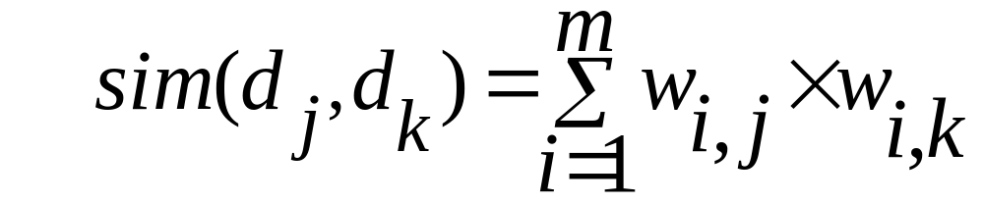
Computing a single cosine
For every term i, with each doc j, store term frequency tf_{ij}.
  Some tradeoffs on whether to store term count, term weight, or weighted by idf_{i}.
At query time, accumulate component-wise sum
If you’re indexing 5 billion documents (web search) an array of accumulators is infeasible
Ideas?

Slide 28
Encoding document frequencies
1,2 7,3 83,1 87,2 …
aargh 2
abacus 8
1,1 5,1 13,1 17,1 …
acacia 35
7,1 8,2 40,1 97,3 …
Add tf_{t,d} to postings lists
  Almost always as frequency – scale at runtime
  Unary code is very effective here
  γ code (Lecture 3) is an even better choice
  Overall, requires little additional space
Why?

Slide 29
Computing the k largest cosines: selection vs. sorting
Typically we want to retrieve the top k docs (in the cosine ranking for the query)
  not totally order all docs in the corpus
  can we pick off docs with k highest cosines?

Slide 30
Use heap for selecting top k
Binary tree in which each node’s value > values of children
Takes 2n operations to construct, then each of k log n “winners” read off in 2log n steps.
For n=1M, k=100, this is about 10% of the cost of sorting.
1
.9
.3
.3
.8
.1
.1

Slide 31
Bottleneck
Still need to first compute cosines from query to each of n docs → several seconds for n = 1M.
Can select from only non-zero cosines
  Need union of postings lists accumulators (<<1M): on the query aargh abacus would only do accumulators 1,5,7,13,17,83,87 (below).
1,2 7,3 83,1 87,2 …
aargh 2
abacus 8
1,1 5,1 13,1 17,1 …
acacia 35
7,1 8,2 40,1 97,3 …

Slide 32
Removing bottlenecks
Can further limit to documents with non-zero cosines on rare (high idf) words
Enforce conjunctive search (a la Google): non-zero cosines on all words in query
  Get # accumulators down to {min of postings lists sizes}
But still potentially expensive
  Sometimes have to fall back to (expensive) soft-conjunctive search:
  If no docs match a 4-term query, look for 3-term subsets, etc.

Slide 33
Can we avoid this?
Yes, but may occasionally get an answer wrong
  a doc not in the top k may creep into the answer.

Slide 34
Best m candidates
Preprocess: Pre-compute, for each term, its m nearest docs.
  (Treat each term as a 1-term query.)
  lots of preprocessing.
  Result: “preferred list” for each term.
Search:
  For a t-term query, take the union of their t preferred lists – call this set S, where |S| ≤ mt.
  Compute cosines from the query to only the docs in S, and choose the top k.
Need to pick m>k to work well empirically.

Slide 35
Exercises
Fill in the details of the calculation:
  Which docs go into the preferred list for a term?
Devise a small example where this method gives an incorrect ranking.

Slide 36
Cluster pruning: preprocessing
Pick √n docs at random: call these leaders
For each other doc, pre-compute nearest leader
  Docs attached to a leader: its followers;
  Likely: each leader has ~ √n followers.

Slide 37
Cluster pruning: query processing
Process a query as follows:
  Given query Q, find its nearest leader L.
  Seek k nearest docs from among L’s followers.

Slide 38
Visualization
Query
Leader
Follower

Slide 39
Why use random sampling
Fast
Leaders reflect data distribution

Slide 40
General variants
Have each follower attached to a=3 (say) nearest leaders.
From query, find b=4 (say) nearest leaders and their followers.
Can recur on leader/follower construction.

Slide 41
Exercises
To find the nearest leader in step 1, how many cosine computations do we do?
  Why did we have √n in the first place?
What is the effect of the constants a,b on the previous slide?
Devise an example where this is likely to fail – i.e., we miss one of the k nearest docs.
  Likely under random sampling.

Slide 42
Dimensionality reduction
What if we could take our vectors and “pack” them into fewer dimensions (say 50,000→100) while preserving distances?
(Well, almost.)
  Speeds up cosine computations.
Two methods:
  Random projection.
  “Latent semantic indexing”.

Slide 43
Random projection onto k<<m axes
Choose a random direction x₁ in the vector space.
For i = 2 to k,
  Choose a random direction x_{i} that is orthogonal to x₁, x₂, … x_{i–1}.
Project each document vector into the subspace spanned by {x₁, x₂, …, x_{k}}.

Slide 44
E.g., from 3 to 2 dimensions
t ₃
d₂
x₂
x₂
d₂
d₁
d₁
t ₁
x₁
x₁
t ₂
x₁ is a random direction in (t₁,t₂,t₃) space.
x₂ is chosen randomly but orthogonal to x₁.
Dot product of x₁ and x₂ is zero.

Slide 45
Guarantee
With high probability, relative distances are (approximately) preserved by projection.
Pointer to precise theorem in Resources.

Slide 46
Computing the random projection
Projecting n vectors from m dimensions down to k dimensions:
  Start with m × n matrix of terms × docs, A.
  Find random k × m orthogonal projection matrix R.
  Compute matrix product W = R × A.
j^{th} column of W is the vector corresponding to doc j, but now in k << m dimensions.

Slide 47
Cost of computation
Why?
This takes a total of kmn multiplications.
Expensive – see Resources for ways to do essentially the same thing, quicker.
Question: by projecting from 50,000 dimensions down to 100, are we really going to make each cosine computation faster?

Slide 48
Latent semantic indexing (LSI)
Another technique for dimension reduction
Random projection was data-independent
LSI on the other hand is data-dependent
  Eliminate redundant axes
  Pull together “related” axes – hopefully
    car and automobile
More on LSI when studying clustering, later in this course.

Slide 49
Resources
MG Ch. 4.4-4.6; MIR 2.5, 2.7.2; FSNLP 15.4
Random projection theorem – Dasgupta and Gupta. An elementary proof of the Johnson-Lindenstrauss Lemma (1999).
Faster random projection - A.M. Frieze, R. Kannan, S. Vempala. Fast Monte-Carlo Algorithms for finding low-rank approximations. IEEE Symposium on Foundations of Computer Science, 1998.

